Slide 1
Transportation Funding Update
August 15th, 2014

Slide 2
Current Revenue Structure
18₵ in FY92 is the same as 4.89₵ in FY13
Yearly Price Range
Notes:
Bituminous- Carbon based, tar like substance: used as a proxy for asphalt costs.
Purchasing power graph shows the decreasing purchasing power of HURF revenue and the Gas Tax relative to tons of Bituminous material (asphalt)

Slide 3
Projected National Trend
^U.S. Energy Information Administration (EIA) Annual Energy Outlook (AEO) 2013; Reference Case Tables A7 & A11. Accessed at: http://www.eia.gov/analysis/projection-data.cfm#annualproj
Notes:
Shows the projected increase in vehicles on the road and the miles those vehicles travel (road damage) to the projected consumption of gasoline (roadway building and repair fund source)

Slide 4
HURF Revenues at FY05 Levels
Since FY00 the State has violated the statutory cap 14 out of 16 years
FY15 County HURF revenues are currently projected at FY05 levels
*ADOT FY15 Projections
Notes:
$10 million statutory cap was first instituted in FY2000. Since then the Legislature has violated the cap 14 out of 16 years.

Slide 5
Motor Fuel Tax Revenue & Expenditures
Source: State & Local Government Finance Data Query System. http://slfdqs.taxpolicycenter.org/ The Urban Institute-Brookings Institution Tax Policy Center. Data from U.S. Census Bureau, Annual Survey of State and Local Government Finances, Government Finances, Volume 4, and Census of Governments (Years). Date of Access: (03-Jun-14 08:22 PM)
Notes:
Arizona has consistently spent less than the national average per capita on regular highway expenditures since 2002 even though we have taken in more fuel tax revenue per capita.
Regular Highway Expenditures Includes: Maintenance, operation, repair, and construction of nontoll highways, streets, roads, alleys, sidewalks, bridges, tunnels, ferry boats, viaducts, and related structures. (includes federal funds)
Regular Highway Expenditures Excludes: Patrol or policing of streets and highways and traffic control activities of police or public safety agencies, street cleaning activities, local public parking facilities or meters, operation of water transport and terminal facilities, roads and walkways within parks and maintained by a park agency, drainage unrelated to highway projects.
Motor Fuel Tax Revenue Includes (If applicable): Taxes on gasoline, diesel oil, aviation fuel, "gasohol", and any other fuels used in motor vehicles or aircraft.
Motor Fuel Tax Revenue Excludes (If applicable): Taxes on sale of fuels other than motor fuels--e.g., for heating, lighting, cooking, etc. --and refunds of fuel taxes (deduct from gross tax proceeds).

Slide 6
Gasoline Excise Tax By State
U.S. Average: 20.51₵
Top Rates
WA | 37.5
NC | 36.5
CA | 36.0
RI | 32.0
KY | 31.1
37.5₵
12.1₵
22.2₵
27.0₵
23.0₵
30.0₵
30.0₵
28.5₵
24.0₵
25.0₵
22.0₵
30.9₵
8.1₵
23.0₵
19.0₵
32.0₵
26.4₵
21.0₵
0.0₵
25.0₵
23.0₵
19.0₵
18.0₵
28.0₵
10.5₵
Low Rates
PA | 0.0
FL | 4.0
GA | 7.5
AK | 8.0
NY | 8.05
24.5₵
20.5₵
36.0₵
22.0₵
24.0₵
17.0₵
14.8₵
23.0₵
31.1₵
20.0₵
36.5₵
23.9₵
18.0₵
17.0₵
16.0₵
16.0₵
21.5₵
23.5₵
18.0₵
7.5₵
20.0₵
16.0₵
20.0₵
8.0₵
4.0₵
17.0₵
Source: American Petroleum Institute (API) 2014 State Motor Fuel Taxes Report.
Note: Rates effective 7/1/2014, U.S. Average represents volume-weighted average.

Slide 7
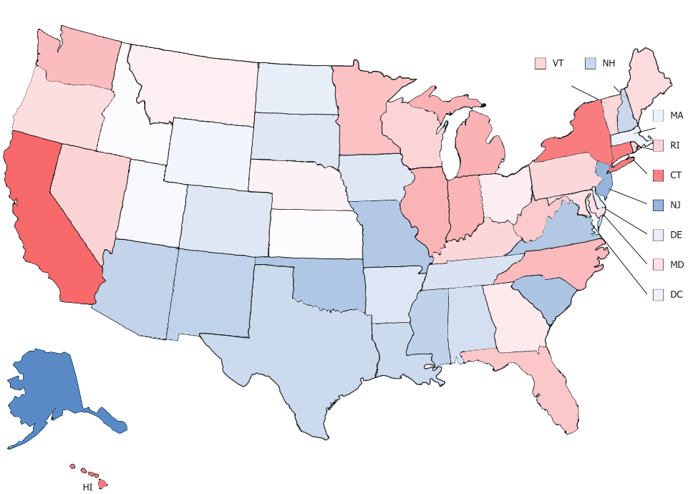
Total Gasoline Tax By State
U.S. Average: 31.22₵
Top Rates
NY | 50.5
CA | 49.8
CT | 49.3
HI | 48.5
MI | 42.0
37.5₵
33.0₵
23.8₵
27.8₵
23.0₵
31.0₵
31.1₵
28.6₵
26.5₵
25.0₵
22.0₵
32.9₵
50.5₵
24.0₵
42.0₵
33.0₵
27.3₵
22.0₵
41.8₵
49.3₵
33.2₵
39.1₵
41.8₵
28.0₵
14.5₵
Low Rates
AK | 12.4
NJ | 14.5
SC | 16.8
OK | 17.0
VA | 17.3
24.5₵
35.7₵
49.8₵
22.0₵
24.0₵
17.3₵
17.3₵
23.0₵
32.5₵
21.4₵
36.8₵
27.4₵
19.0₵
18.9₵
17.0₵
21.8₵
16.8₵
23.5₵
18.4₵
20.87
27.5₵
20.0₵
20.0₵
12.4₵
36.0₵
48.5₵
Examples of Other State Taxes/Fees:
Under Ground Storage Tank Charge
Average Local Option
Environmental Fees
Source: American Petroleum Institute (API) 2014 State Motor Fuel Taxes Report.
Note: Rates effective 7/1/2014, U.S. Average represents volume-weighted average.
Notes:
Notice the large difference including other fees can make. i.e. NY goes from bottom five to number one

Slide 8
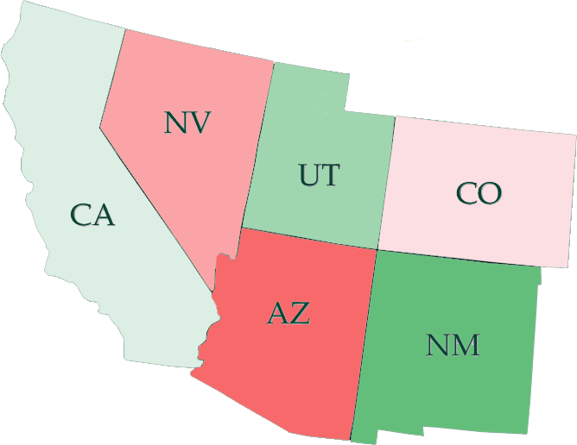
VLT (In-Lieu) Comparison
4% of 75% of original MSRP (valuation), depreciated every year
Fee Schedule based on the age of the vehicle:
· Less than 3: $150
· 3-5: $110
· 6-8: $80
· 9-11: $50
· 12 or more: $10
Numbers reflect estimated tax on a 3 year old $20,000 Car
0.65% of Current Market Value (as determined by the Dept. of Transportation)
$210
$110
Variable rate (0.45% to 2.10%) of 85% on the original MSRP
$204
$130
$243
$2.89 (used) or $2.80 (new) per $100 NAV, calculated by taking 60% of the manufacture's base retail price and reducing it by 16.25% each year
$0
No “in-lieu” tax but registration fees range from $27.00-$62.00 based on weight and model year
Notes:
California calculation: $20,000 (Current Value) X 0.65% =$130 (20,000X0.0065) = 130
Nevada calculation: $20,000(Original MSRP) X 35% = $7,000;
$7,000 X 75% (Depreciation: 5% 1st yr., 10% 2nd &3rd yrs.) = $5,250
$5,250 X 4% = $210
{[(20,000X0.35)X0.75]X0.04}=210
Utah calculation: Flat fee Schedule for passenger vehicles charges $100 for 3 year old vehicles.
Colorado calculation: $20,000(Original MSRP) X 85% = $17,000
$17,000 X 1.20% (tax rate for 3rd year registration) = $204
[(20,000X0.85)*0.012]=204
Arizona calculation: $20,000 (Manufacture’s base retail) X 60% = $12,000
$12,000 X 83.75% (1yr depreciation) = $10,050
$10,050 X 83.75% (2yr depreciation) = $8,417
$8,417 / $100 = $84.17NAV
$84.17 X $2.89 = $243
{[(20,000X0.60)*(0.8375)*(0.8375)]/100}X2.89=210

Slide 9
Revenue Raising Options
Revenue Raising Options | Examples
Increase in the Motor Fuel Excise Tax (cents per gallon) | Wyoming passed a 10cpg increase
Increase Vehicle Registration Fee (flat fee for registration) and/or Vehicle License Tax (fix rate based on the assessed value of the vehicle) | Virginia added a $64 registration fee for alternative fuel vehicles
Index the Motor Fuel Excise Tax to adjust for Inflation | A portion of Florida’s excise tax is indexed to the Consumer Price Index (CPI)
Local Option (local governments levy a gas excise tax) | Florida localities can charge up to 0.06cpg or transportation needs

Slide 10
Revenue Raising Options (cont.)
Revenue Raising Options | Examples
Institute a Value Capture Revenue model (assessing parcels receive a benefit from a project) | Connecticut State law allows for an assessment district for Value Capture Revenue
Vehicle-Miles Traveled (VMT) fees (tax the miles traveled based on weight) | Oregon completed a Road User Fee Pilot Program in 2007, a tax was levied based on weight and miles driven, which The tax was paid at the pump
Sales Tax (tax the total purchase price) | Virginia passed legislation that eliminates the gas tax and replaces it with a sales tax increase of 0.3% dedicated to transportation

Slide 11
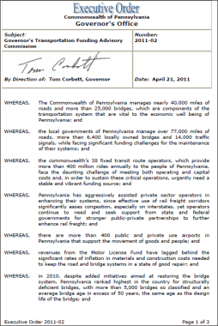
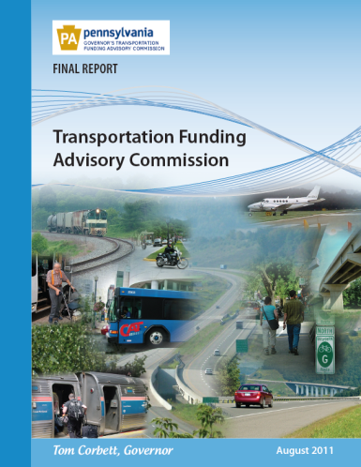
Pennsylvania Example
APR 2011 –Transportation Funding Advisory Commission (TFAC) created by EO
Purpose: to “develop a comprehensive, strategic proposal for addressing the transportation funding needs of Pennsylvania.”
AUG 2011 – TFAC publishes their final report which included the following recommendations (millions $):
Cap or move the State Police costs to the General fund ($0-$300)
Increase vehicle & driver fees for inflation ($574)
Uncap Oil Company Franchise Tax (OCFT) ($1,361)
Vehicle Fees for Localities ($110)
Dedicate 2-percent of existing sales tax to transit ($172)
2012 – PennDOT publishes the Next Generation Progress Report, detailing modernization efforts & $50-$70 million in cost-savings.
Notes:
On April 21, 2011 Governor Tom Corbett signed Executive Order 2011-02 creating the Governor’s Transportation Finance Advisory Commission with the stated purpose of: “develop[ing] a comprehensive, strategic proposal for addressing the transportation funding needs of Pennsylvania”

Slide 12
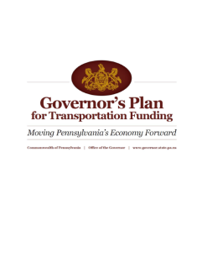
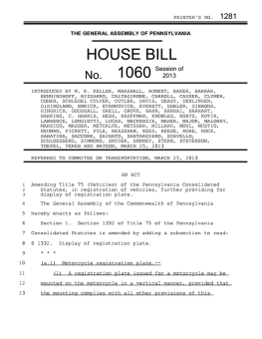
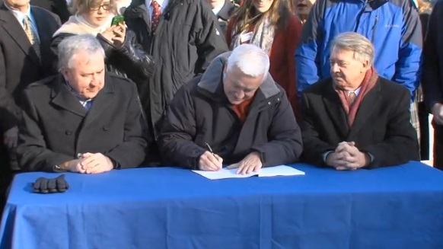
Pennsylvania Example (cont.)
FEB 2013 – Governor Corbett releases his Plan for Transportation Funding
Decreases “at the pump” gas tax
5 year phased in elimination of the cap on OCFT
Options for Counties to assess a $5 registration fee
MAR 2013 – HB 1060 is introduced in the PA General Assembly
NOV 2013 – Signed by Governor Corbett
Uncapping the OCFT
Local option registration fee
Provides for a “bundling” program to help decrease local design and construction costs
Increases vehicle fees and indexes for inflation
5 year estimate of additional funding is $2.3 - $2.4 billion

Slide 13
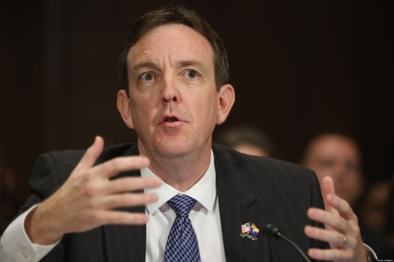
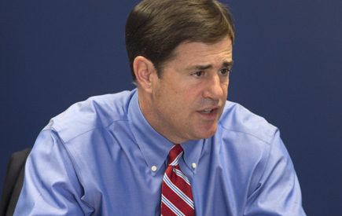
What do the Gubernatorial Candidates Think?
“During the state’s economic downturn, the legislature swept millions in Highway User Revenue Funds (HURF) to balance the budget. This practice must not continue. These resources should be used for highway construction, improvements and other important projects. Our transportation infrastructure is critically important when it comes to travel and tourism, especially in our rural areas.”
–Ken Bennett
“The primary problem with our transportation funding is that those dollars are simply not being used the right way. As governor, I’ll do my part and make sure the state stops sweeping the funds intended to build and maintain roads in our state and rural communities. The amount of Highway User Revenue Fund (HURF) money that has been swept since 2002 is roughly $750 million. It’s bad budget management and I won’t stand for it.”
- Doug Ducey

Slide 14
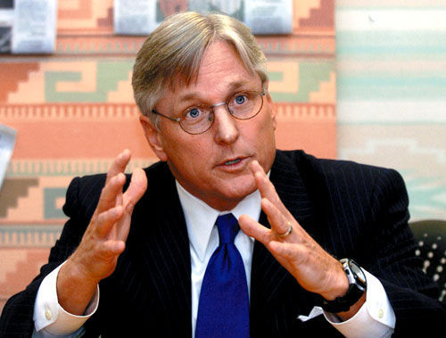
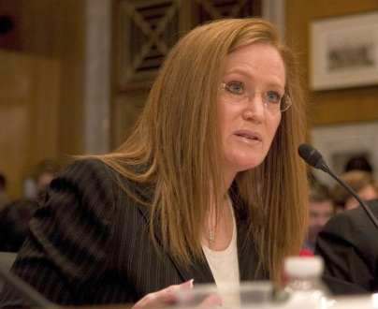
What do the Gubernatorial Candidates Think?
“During the lean years of the Great Recession, our legislature swept funds from our primary source for new road construction and highway repair. Not only has that left too many of our roads in a state of disrepair, but we lost out on opportunities to create quality jobs when our state needed them the most. First, we need to stop sweeping HURF funds for other purposes. Second, we need to start working with the federal government to secure investments that will improve our transportation infrastructure and allow us to expand our trade with Mexico.”
–Fred DuVal
“Transportation and infrastructure greatly impact Arizona’s economy and supporting Arizona’s infrastructure growth is at the top of my priority list. Transportation and infrastructure are to our economic health what air and water quality and health care are to our physical health. Since growth continues to outpace our investment, we must catch up and begin to invest long term for the future.”
– Christine Jones

Slide 15
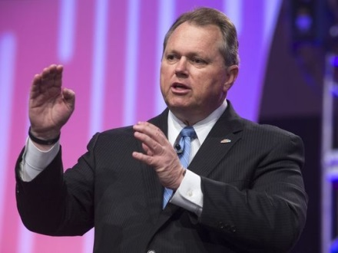
What do the Gubernatorial Candidates Think?
“It is essential to our state’s economic health that we have a safe, well-maintained transportation system, one that can grow and adapt to our residents’ and industries’ needs. One of my top priorities as Governor will be to work with the legislature and/or Arizona voters to ensure there is adequate funding to build and maintain our streets and roads. To begin, HURF funding must be restored and protected from future sweeps to balance the State’s general fund.”
– Scott Smith

